Slide 1
Strengthening water and sanitation regulatory systems
A Global Call to Action

Slide 2
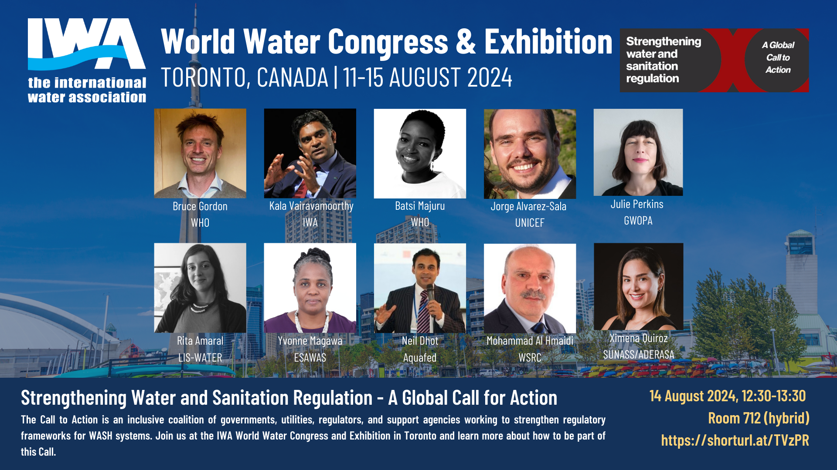

Slide 3
Session objectives
Sensitize participants to Call to Action
Initiate process and roadmap for development

Slide 4
Agenda
Session opening | Daniela Bemfica ¦ IWA
Opening remarks | Bruce Gordon ¦ WHO Kala Vairavamoorthy ¦ IWA
Overview of Call to Action | Batsirai Majuru ¦ WHO
Q&A | Moderator: Robert Bos
Why we need stronger recognition of the role of regulation in strengthening water and sanitation services: | Yvonne Magawa ¦ ESAWAS Ximena Quiroz-Pita ¦ ADERASA Julie Perkins ¦ GWOPA Rita Amaral ¦ LIS-Water Jorge Alvarez-Sala ¦ UNICEF
 | Neil Dhot ¦ Aquafed Mtchera Chirwa ¦ ADB
Closing remarks and vision for the future | Mohammad Al-Hmaidi ¦ WSRC Daniela Bemfica ¦ IWA

Slide 5



Why now?
Weak enabling environment
Persistent inequalities in types of services that are regulated
Chronic underinvestment in water and sanitation services
Exacerbated by climate change, all these factors severely threaten progress towards universal access to safely managed drinking water and safely managed sanitation
Notes:
Why do we need to strengthen regulatory systems for water and sanitation services?
The environment in which regulators are operating in needs to be improved; fragmented legislation and policies, limited functions and related authority all impede the ability of regulatory institutions to carry out their responsibilities effectively
In many countries non-sewered sanitation / non-piped water supplies remain outside of the purview of regulatory frameworks
Investment in the water and sanitation sector is generally low, and will likely continue to be so with a looming global economic crisis

Slide 6
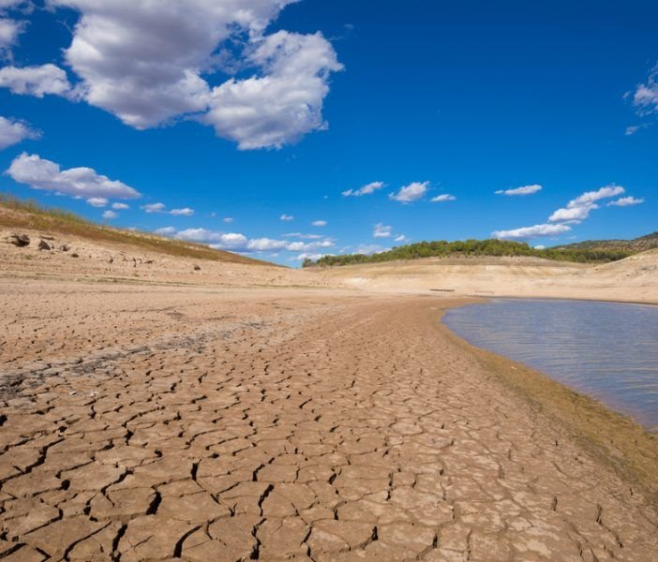
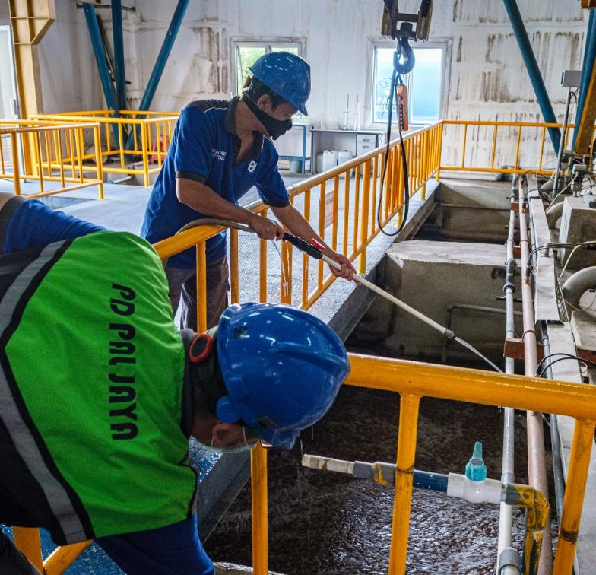
Vision
An enabling environment: Improve the political space that regulators are working in
Addressing inequalities: Establish / extend regulatory mandates to services that are currently unregulated
Strengthening implementation: strengthening existing regulatory institutions + regulators’ associations, supporting establishment of additional ones

Slide 7

Objectives
Increasing political recognition of the role of effective regulation in improving water and sanitation services
Promoting uptake of good regulatory practices, including working frameworks and approaches that improve service delivery.
Promoting enhanced and better coordinated technical assistance from external support partners
Strengthening monitoring of the status of water and sanitation regulation
Notes:
Increasing political recognition: strengthen national leadership; define roles, responsibilities, powers and collaborative opportunities for stakeholders; highlight critical role of regulation and empowerment; establish/maintain funding mechanisms; develop national roadmaps.
Promoting uptake of good regulatory practices: working frameworks and approaches that improve service delivery.
Promoting enhanced and better coordinated technical assistance: increase financial and technical support; foster knowledge sharing and collaboration among external support agencies, financing institutions.
Monitoring the status of water and sanitation regulation: establishing robust mechanisms for monitoring and evaluating; use data and evidence to inform policy adjustments and improvements; regularly publish reports on the status of and progress on water and sanitation regulation

Slide 8
What would be in the Call to Action?
The ask
What regulatory institutions need to be effective
The rationale
What effective regulatory institutions bring to the sector
Key actions by stakeholders
Notes:
- What would be in the Call to Action?

Slide 9
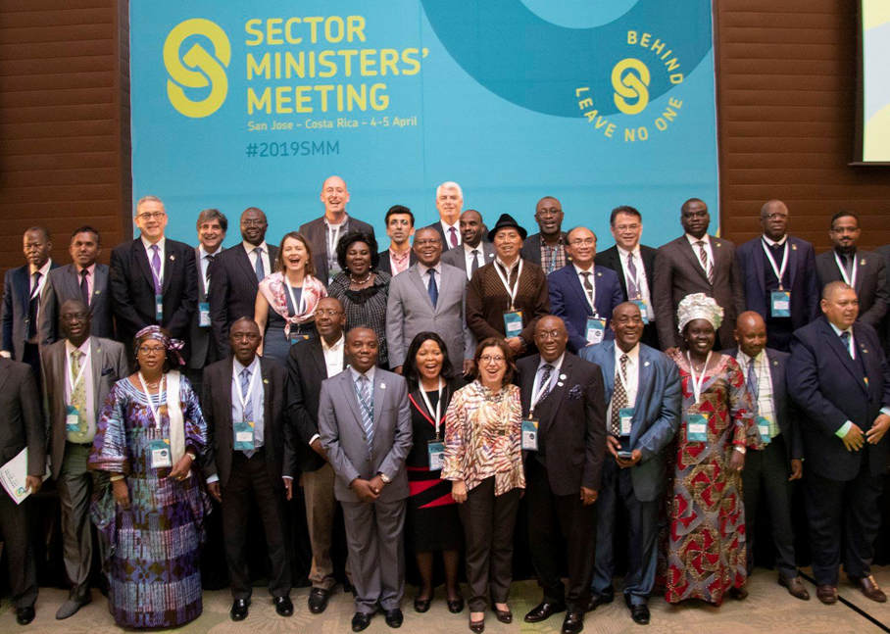
Who is implicated?
Water and sanitation regulators
Utilities / service providers
Governments
External support partners
Financing institutions

Slide 10














Who is involved
More to join…

Slide 11

What’s next?
Announce Call to Action initiative (Aug 2024)
Initiate consultation process, including engaging government + utility groups (Aug-Oct 2024)
Sensitize audiences at various water + sanitation forums (Aug-Nov 24)
Launch Call to Action (Nov 2024)
Follow up activities and continued engagement with partners initiatives (2025…)

Slide 12
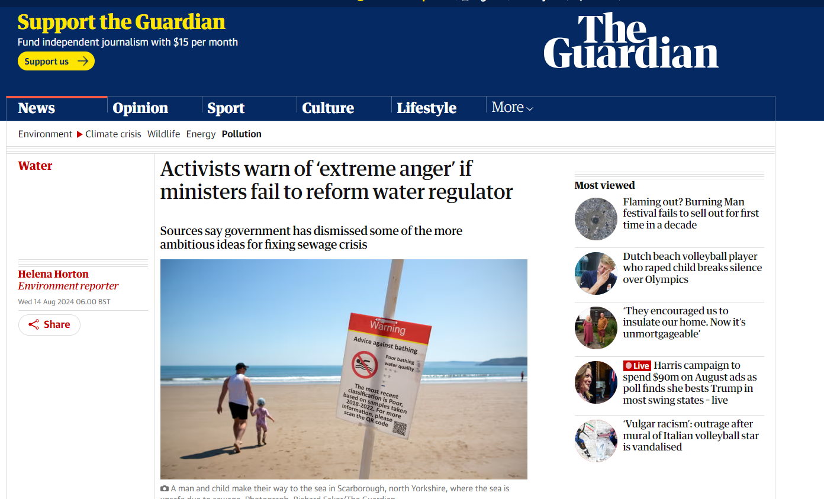
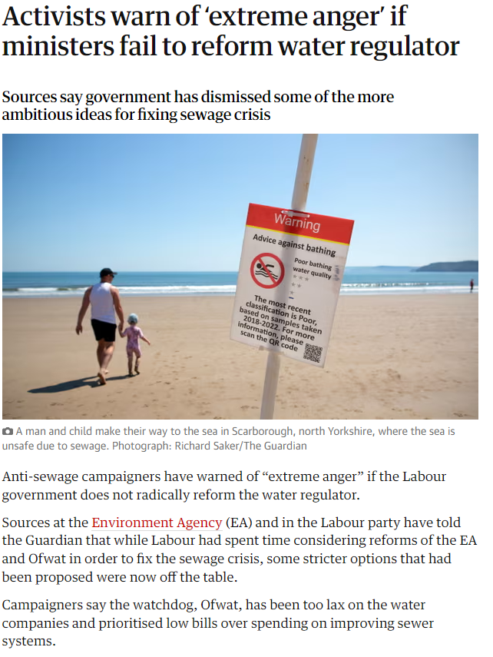

Slide 13

Interested in being part of the Call to Action..?
Want to find out more..?
Have comments, input you would like to share..?
wsh@who.int
online platform coming soon!
Notes:
Why speak up? Not for attention, but with intention

