Slide 1
2024 IWA YOUNG WATER PROFESSIONALS STEERING COMMITTEE ELECTIONS
APRIL 2024

Slide 2
House rules
Be polite
Be respectful
Be present
Engage fully
Ask for clarification
No discrimination

Slide 3
Event information
This event will be recorded and made available “on-demand” on the IWA Connect Plus, with presentation slides, and other relevant information
Post questions using the chat function and feel free to introduce yourselves briefly to one another! Also, it is okay to share your social media
Mute/camera in the bottom left corner
No need to share screen as slides have been added to this presentation

Slide 4
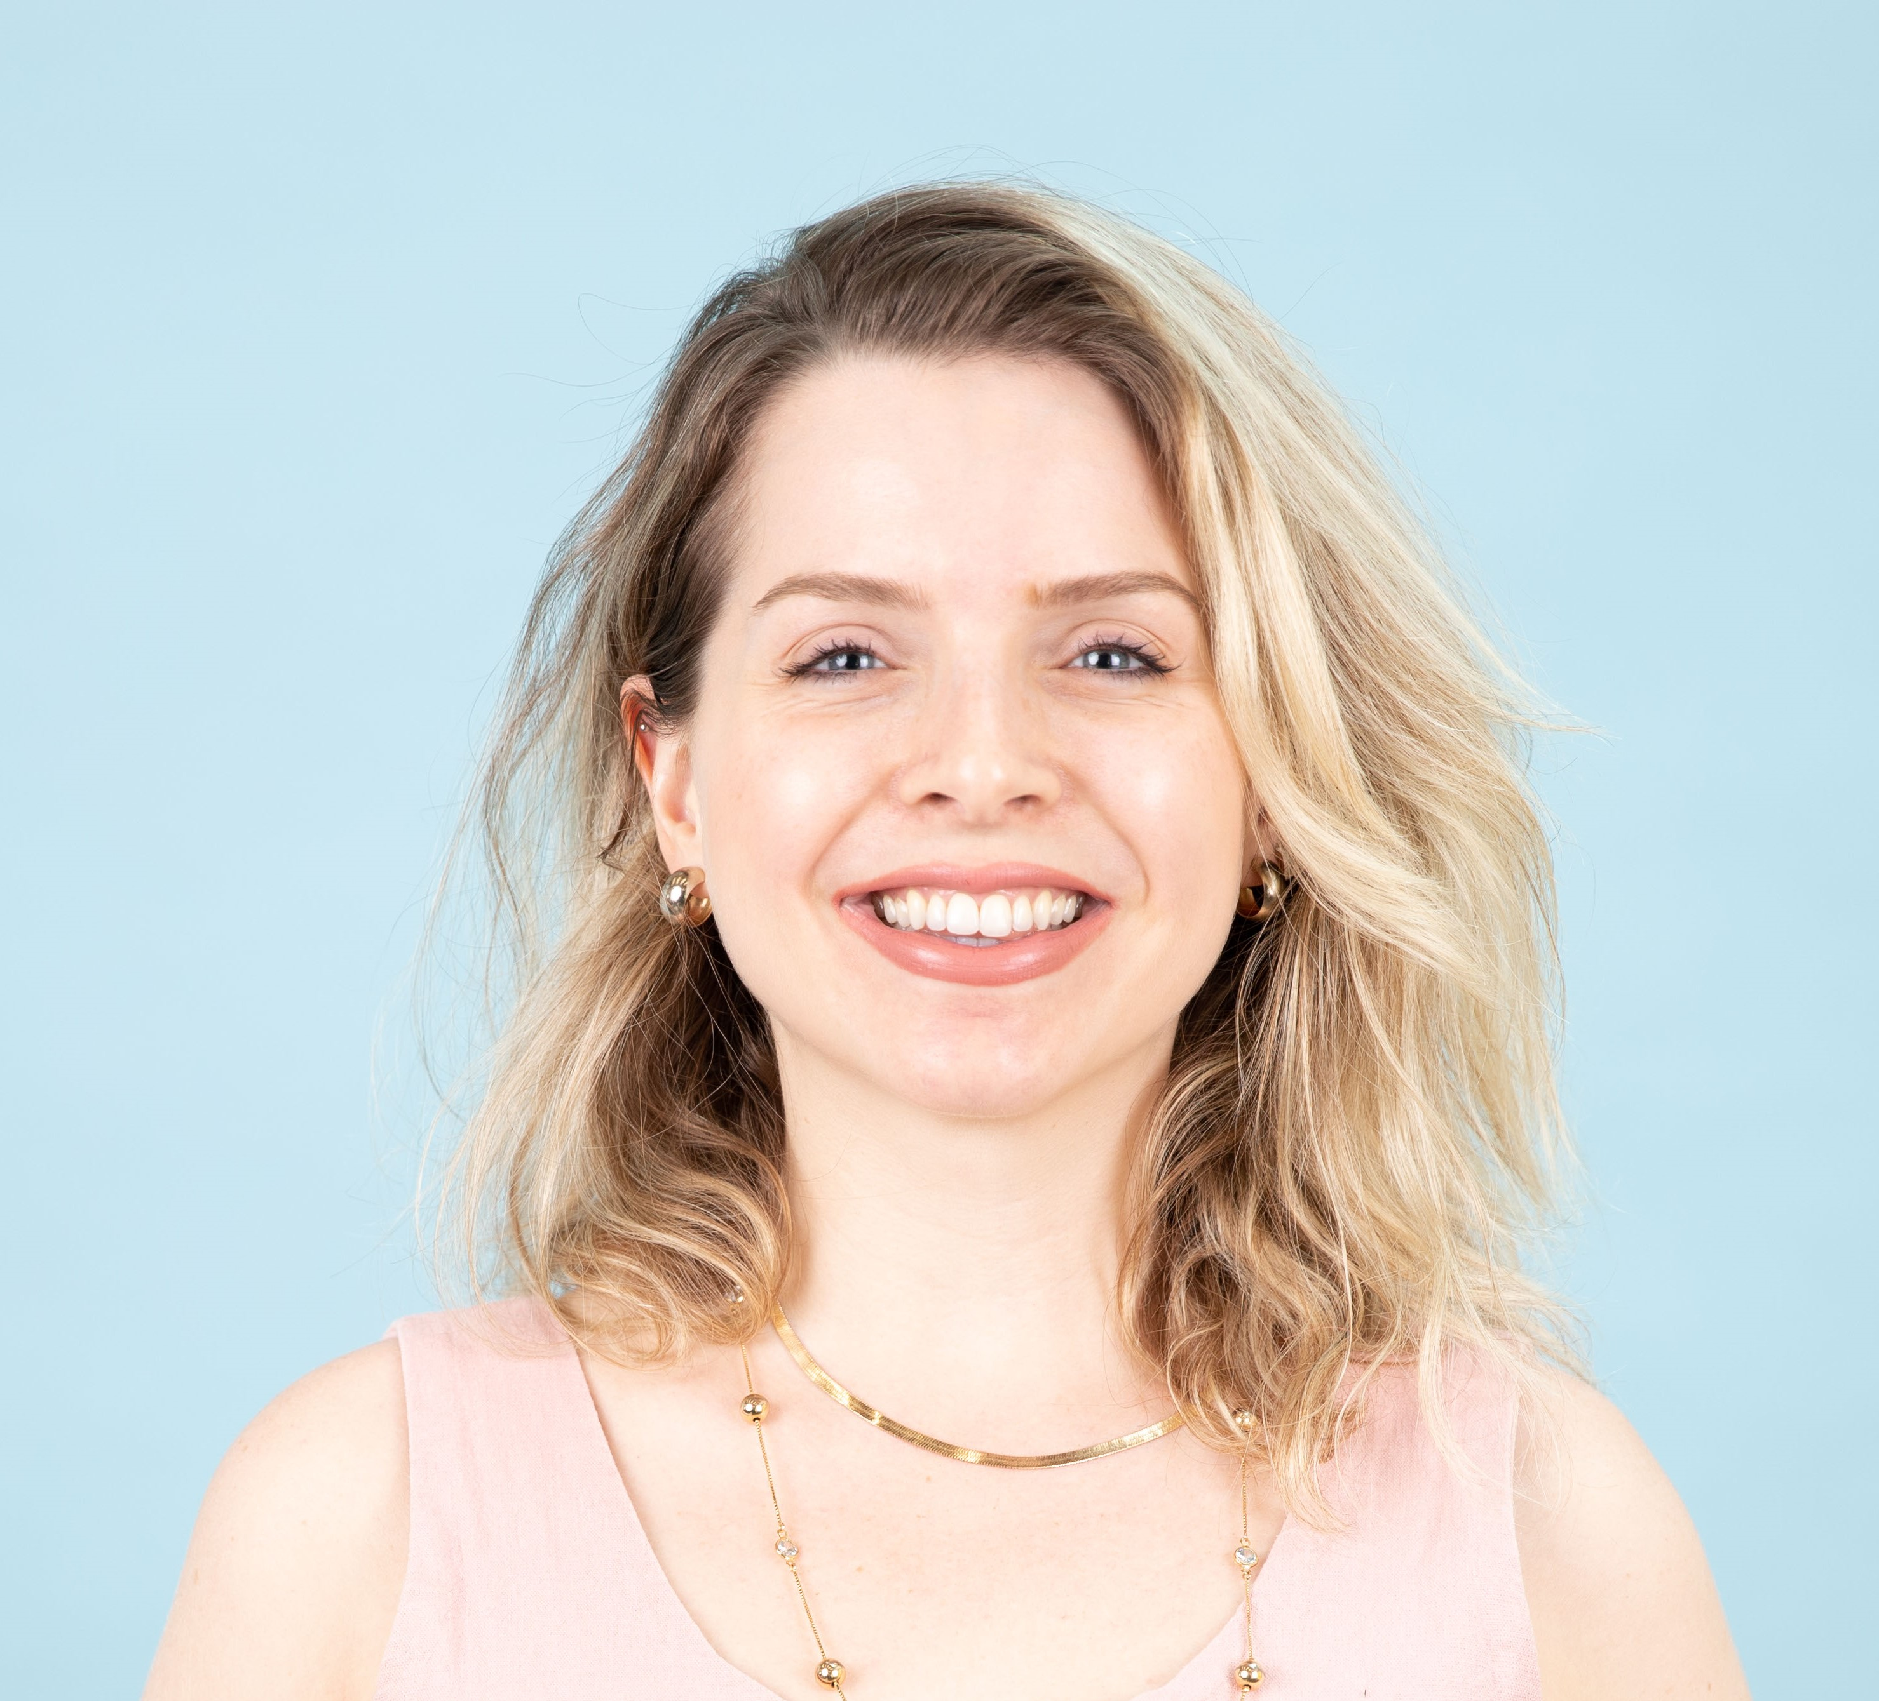
Host (IWA staff)
Isabela Espindola
(she/her)
Senior Officer (YWPs & Regulators)

Slide 5
agenda
Opening remarks
IWA Young Water Professionals Community
IWA Young Water Professionals Steering Committee
Elections
Nominations Committee
Timeline
Positions & Eligibility
How to vote
Candidates' presentations
Chair
Vice chair
Secretary
Q&A
Final remarks

Slide 6
IWA YOUNG WATER PROFESSIONALS Community

Slide 7
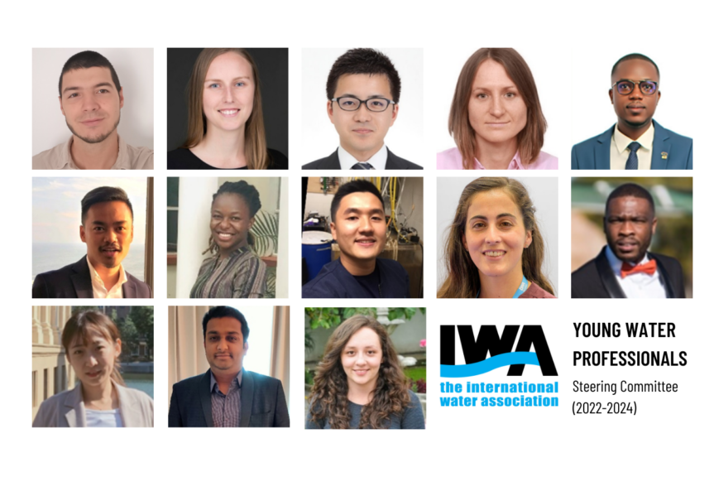
Young water professionals steering committee
Representative body of IWA YWP members
Volunteer-based
Provide advice to IWA about the appropriate ways to serve young professionals’ needs
Lead the YWP community to contribute to IWA’s activities at the national and global level
Provide regional representation for IWA YWP members and actively pursues opportunities to contribute to the IWA network
Elected every 2 years

Slide 8
Young water professionals steering committee
2024 Elections
Nominations Committee

Slide 9
Young water professionals steering committee
2024 Elections
Timeline
Late February: Call for Nominations opens on Connect Plus.
End of March: Submission deadline 31 March.
7 April: Final extended deadline for submissions.
Early April: The IWA Secretariat and Nominations Committee checks the eligibility of candidates.
Mid-April: Nominations Committee puts voting forward (ensuring gender/geographical/age/ background diversity).
End of April: IWA Secretariat organises online hustings for Chair, Vice-Chair and Secretary.
Early May: end of the voting period.
1 May: final deadline for voting
Mid-May: The Nominations Committee presents voting process outcomes to the Governance and Nominations Committee and a recommendation is presented to the IWA Board.
Mid-June: A new committee is presented (online announcement).

Slide 10
Young water professionals steering committee
2024 Elections
Positions
Chairperson
Vice-Chair
Secretary
Strategic Advisory (2 positions)
Specialist Group – YWP coordination (2 positions)
YWP Chapter Coordination (2 positions)
YWP Events and Communications (2 positions)
Career Building (2 positions)
Eligibility
Have been an IWA Member with an active membership for at least 1 year
35 years old or younger upon election
Fulfil the criteria per role
The specific roles have their additional eligibility. Make sure to check the Guidance Document for more information.

Slide 11
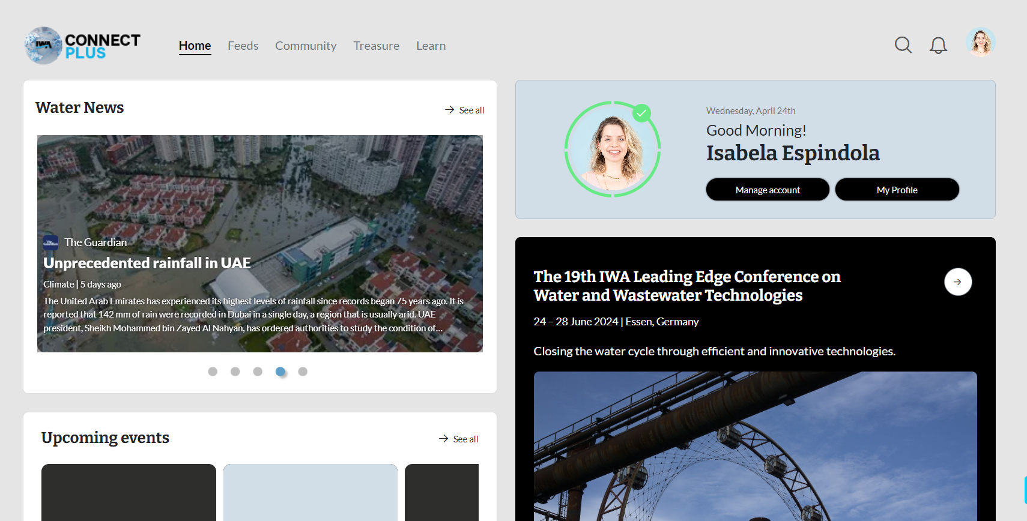
Young water professionals steering committee
2024 Elections
How to vote
Access IWA Connect Plus: https://www.iwaconnectplus.org/
Go to Community

Slide 12
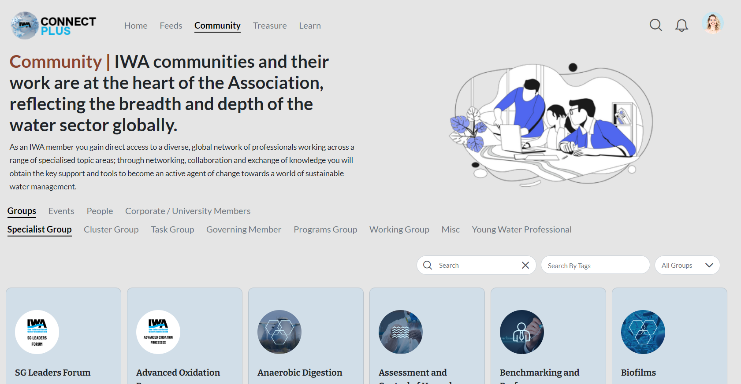
Young water professionals steering committee
2024 Elections
How to vote
Access IWA Connect Plus: https://www.iwaconnectplus.org/
Go to Community
Young Water Professionals

Slide 13
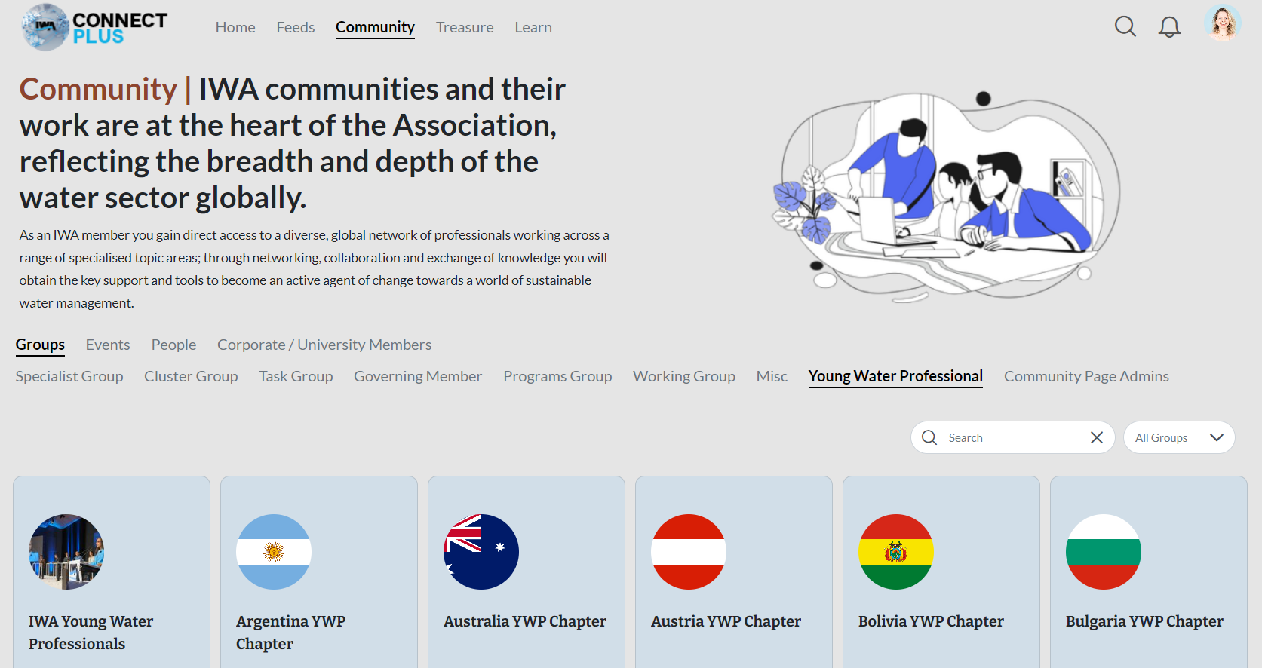
Young water professionals steering committee
2024 Elections
How to vote
Access IWA Connect Plus: https://www.iwaconnectplus.org/
Go to Community
Young Water Professionals
IWA Young Water Professionals

Slide 14
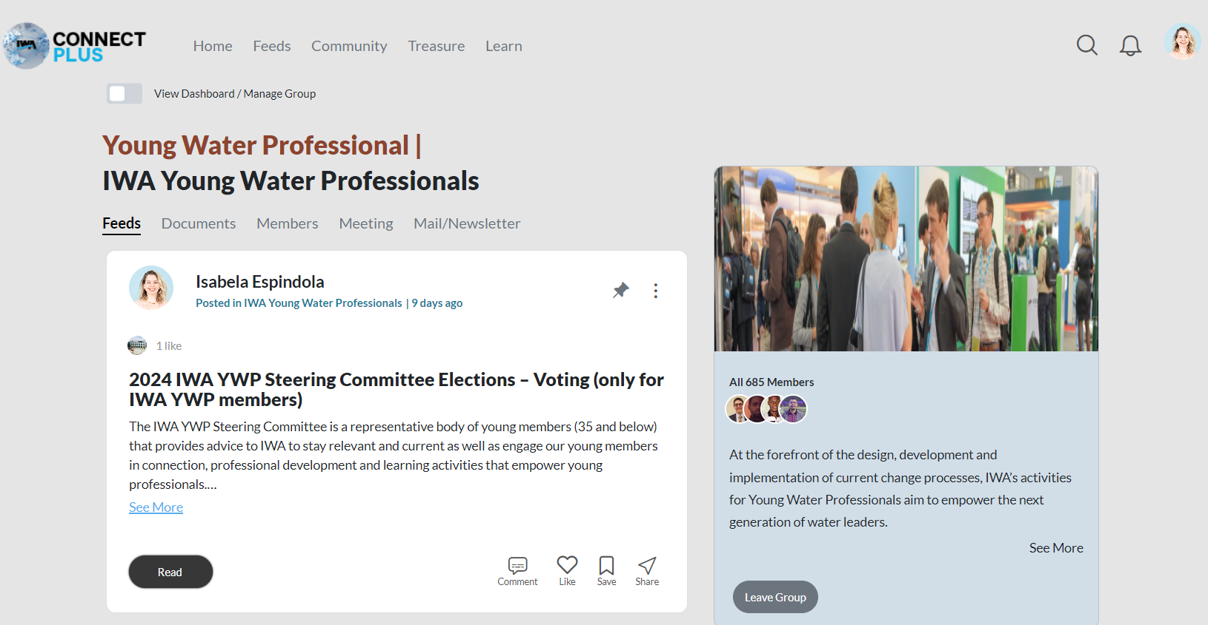
Young water professionals steering committee
2024 Elections
How to vote
Access IWA Connect Plus: https://www.iwaconnectplus.org/
Go to Community
Young Water Professionals
IWA Young Water Professionals
Follow the instructions on the post

Slide 15
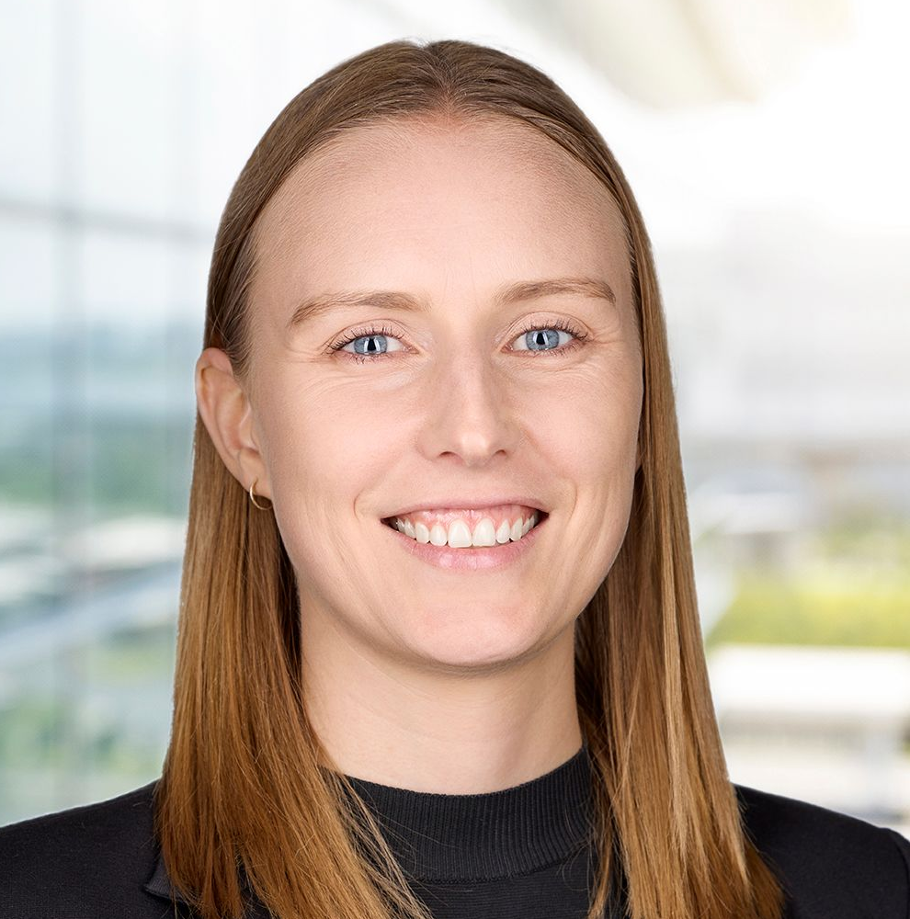
Young water professionals steering committee
2024 Elections
Candidates
Chairperson
Chelsea Hayward
(she/her)
Australia YWP Chapter
Ashton Mpofu
(he/him)
South Africa YWP Chapter

Slide 16
Young water professionals steering committee
2024 Elections
Candidates
Chairperson
Chelsea and Ashton, you both have been involved in the activities of the Steering Committee over the last two years. In the event of becoming the Chair, how will you coordinate the different skills and abilities of the Steering Committee Members to deliver value to the YWP Community? And what is your value proposition to the Community for your term of office?
Is there a particular reason that motivates you to nominate yourself as a chair? What impact it may have on you and other YWPs?
What would be your biggest mission while being a chair, as a leader of the young water professionals community, for these next two years?
What in your point of view are the best ways to engage and empower youth in the water sector?
Can you provide examples of strategies you would like to implement to encourage active participation and engagement from YWPs within the IWA community?
Chelsea Hayward
(she/her)
Australia YWP Chapter
Ashton Mpofu
(he/him)
South Africa YWP Chapter

Slide 17
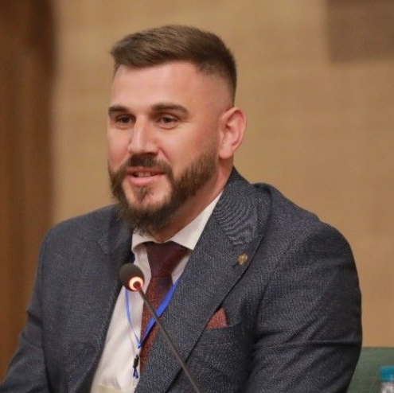
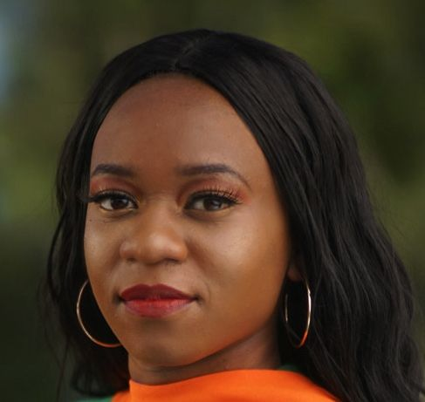
Young water professionals steering committee
2024 Elections
Candidates
Vice-chair
Chelsea Hayward
(she/her)
Australia YWP Chapter
Natalie Lamb
(she/her)
UK YWP Chapter
Albert Salltakaj
(he/him)
Kosovo YWP Chapter
Natasha Mumba
(she/her)
Zambia YWP Chapter

Slide 18
Young water professionals steering committee
2024 Elections
Candidates
Vice-chair
As the Vice Chair, how do you plan to support your Chair deliver their vision for the YWP Community? Considering your responsibility of coordinating the activities of the sub-committees, how will you ensure it is carried out effectively and brings progress?
What challenges are the most significantly impacting YWPs from your point of view? What may be the ways forward to solve it? Would you try to advocate the solutions being in the position of the vice-chair?
What region/regions may require more focus for engagement and empowering youth in the water sector from your point of you?
How do you see the role of YWPs in five years?
Chelsea Hayward
(she/her)
Australia YWP Chapter
Natalie Lamb
(she/her)
UK YWP Chapter
Albert Salltakaj
(he/him)
Kosovo YWP Chapter
Natasha Mumba
(she/her)
Zambia YWP Chapter

Slide 19
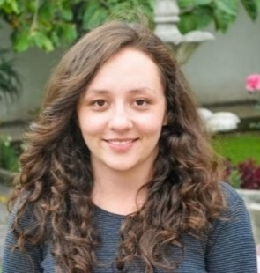
Young water professionals steering committee
2024 Elections
Candidates
Secretary
Claudia Prehn
(she/her)
Ecuador YWP Chapter
Xorse Doe-Bansah
(he/him)
Ghana YWP Chapter

Slide 20
Young water professionals steering committee
2024 Elections
Candidates
Secretary
The role of the secretary is crucial for the effective dissemination of information and operation of the Steering Committee, what innovations and strategies will you introduce to ensure the clear and timely sharing of information and reception of feedback to achieve optimum productivity?
What is your vision of the role of Secretary of the IWA YWPs management committee? What made you to be interested in this role?
What topics may be the most interesting for young professionals to engage in in the next two years?
How can the IWA YWP Steering Committee best communicate with the whole YWP community? Any approaches to advice?
How do you plan to ensure effective communication and collaboration among committee members to achieve the goals of the IWA YWP Steering Committee, and the IWA Strategic Plan?
Claudia Prehn
(she/her)
Ecuador YWP Chapter
Xorse Doe-Bansah
(he/him)
Ghana YWP Chapter

Slide 21
Q&A
Post questions in the chat or feel free to raise your hands and open your mic

Slide 22
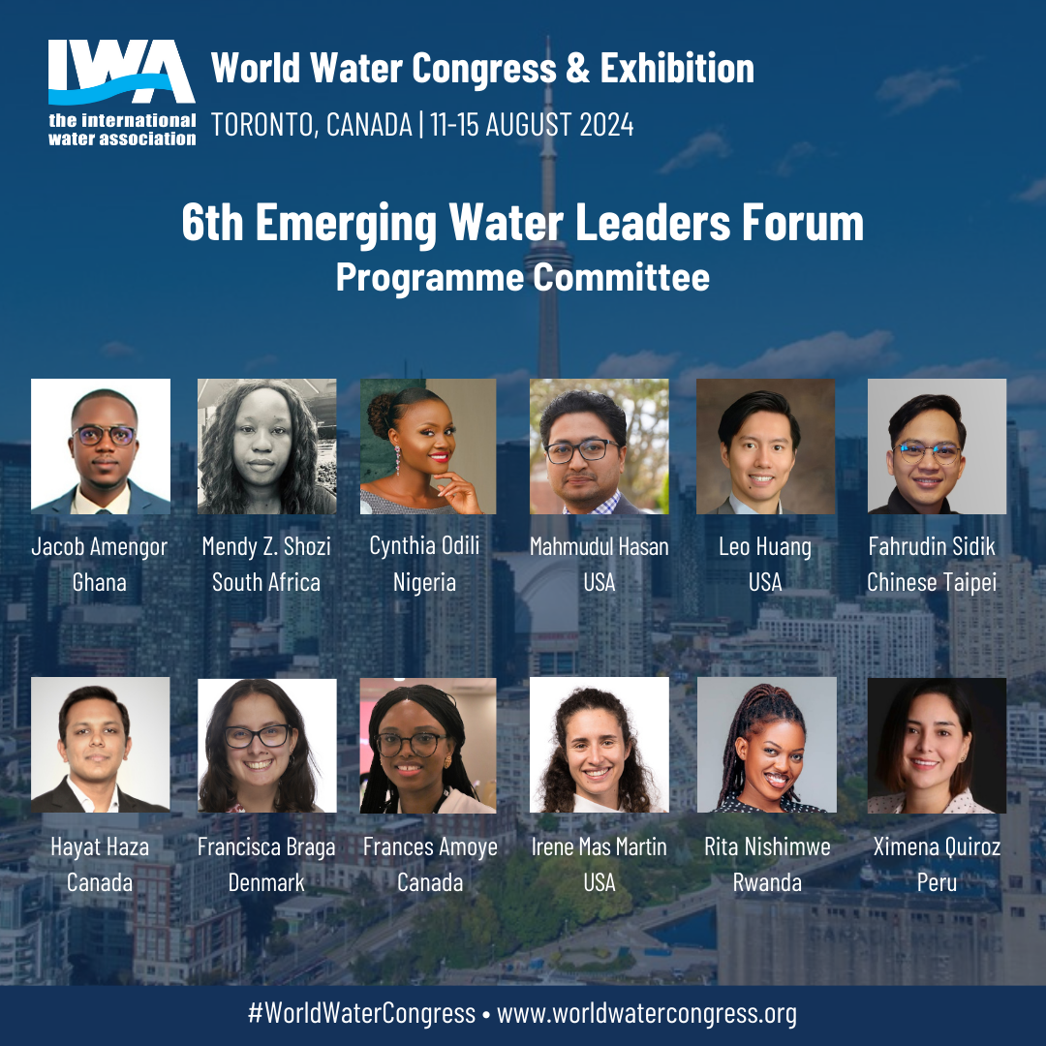
YWP Engagement during IWA World Water Congress
Emerging Water Leaders Forum
YWP dinner/reception
IWA YWP Steering Committee
in-person meeting
IWA YWP Chapter of the Year
IWA YWP Award
Chairs and Rapporteurs during sessions
Keynote Speakers

Slide 24
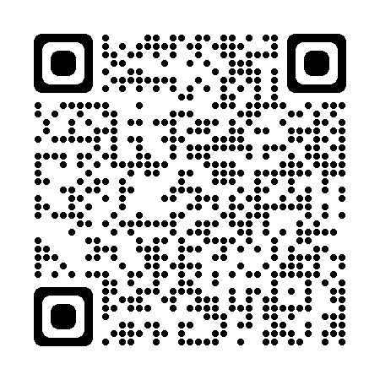
Learn more at https://iwa-network.org/

