Slide 1


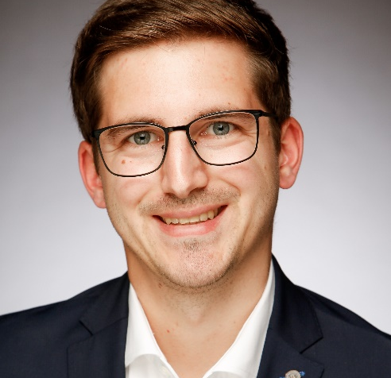
TRiM®online –
Webservice for Technical Risk Management
Martin Offermann
IWW Water Centre, Germany

Slide 2
IntRoduction
About IWW
  Research, consulting and training centre for drinking water, bathing water, process water, industrial water and waste water
  Part of DVGW - German Technical and Scientific Association for Gas and Water
  6 departments (Water Resources Management, Water Technology, Water Networks, Water Quality, Applied Microbiology, Water Economics & Management)
  Over 140 scientists, engineers, economists and technicians
  6 software developers
About TRiM®online
  Commercial webservice (SaaS) for German water (and gas) suppliers
  Started with a R&D project co-financed by innogy SE and in cooperation with four German water suppliers
  Output of the project was the development of a self-check for small and medium sized water suppliers for the implementation of a technical risk management

Slide 3
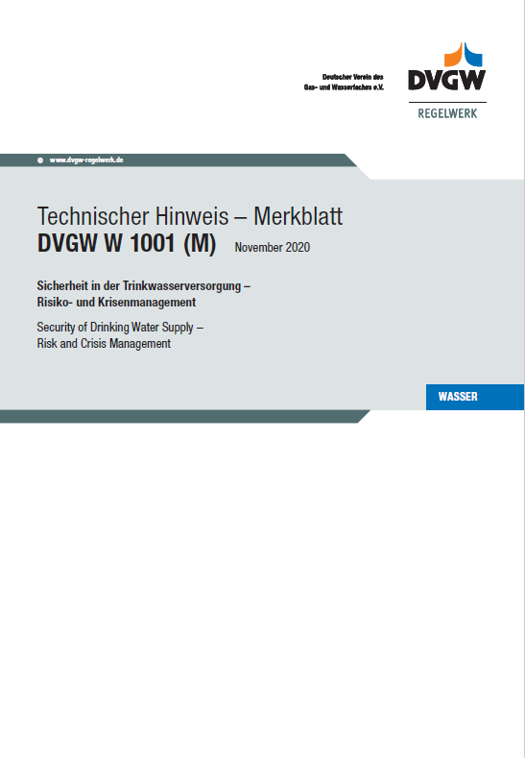
WSP in Germany
WSP in Germany:
  Water Safety Planning aka Technical Risk Management in Germany
  Deals with risks related to water safety and security (quality and quantity)
  Part of the technical standard of DVGW since 2008, DIN EN standard since 2013
  Will become mandatory as part of the implementation of the EU Drinking Water Directive
Challenges:
  Heterogeneous structure of water suppliers; many very small water suppliers; multi-utilities supplying several sectors, as gas, electricity, …
  Limited human, financial and technical resources
  Limited methodological knowledge
  Up to now, risk management is not mandatory
Structure of the German water supply in 2010
Number of water suplliers
Volume of water

Slide 4
Risk Management Approach
Where can something happen?
What can happen and how?
What are the associated risks?
How can the risks be better managed?
How do you determine whether the measures are effective?
Is the risk management well documented?
Has anything changed?
DIN EN 15975-2
Drinking Water Supply System Description
Documentation
Hazard Analysis
①
⑥
Risk assessment
②
⑦
Risk Control
③
Review
Verification of the Risk Management Approach
④
⑤
Source: DIN EN 15975-2:2013

Slide 5
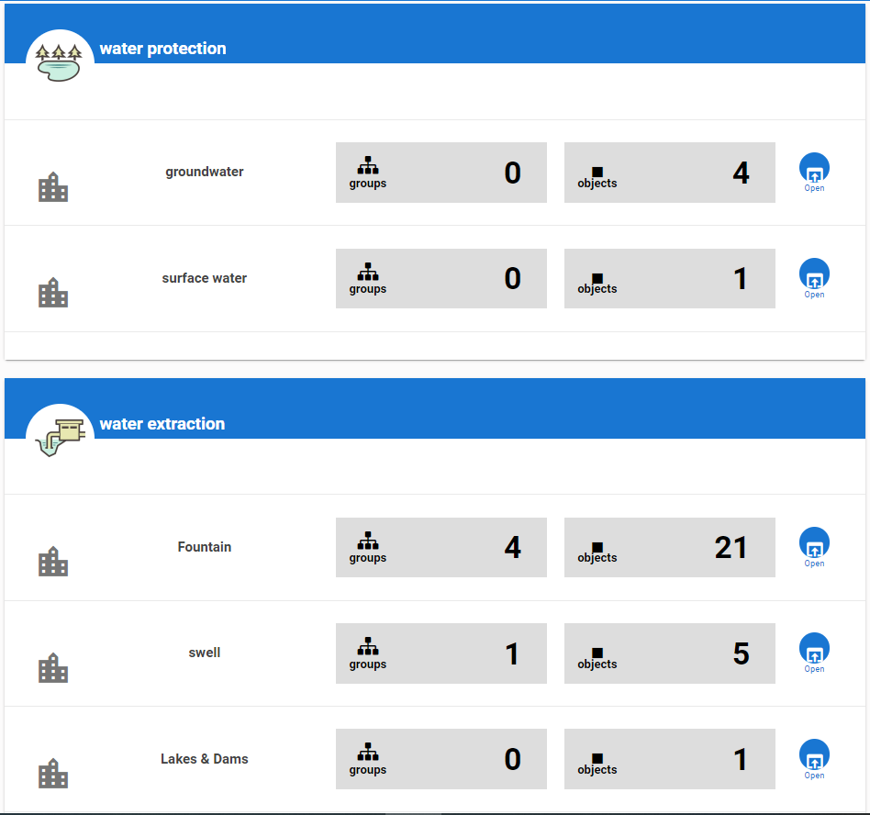
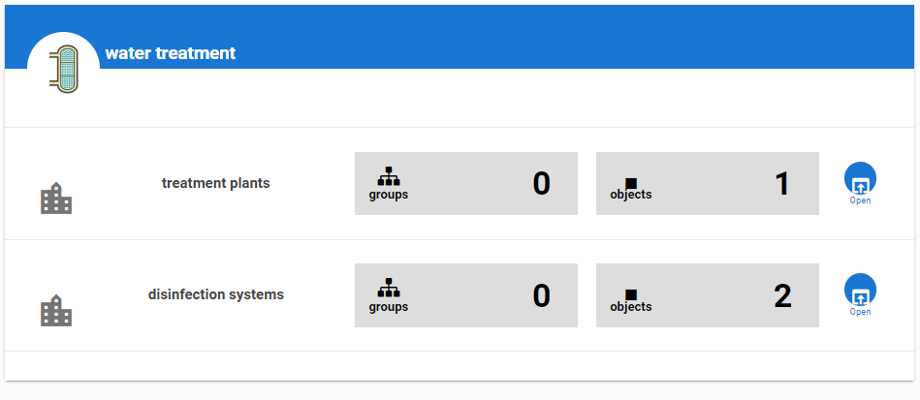
Drinking Water Supply System Description
Supply chain from source to tap:
  organization & management
  water catchment
  water extraction
  water treatment & desinfection
  water pumping & storage
  Water transport & distribution
User has to add different assessment objects of the supply system , e.g.
  boreholes,
  storage tanks,
  pumping stations,
  mains
  …

Slide 6
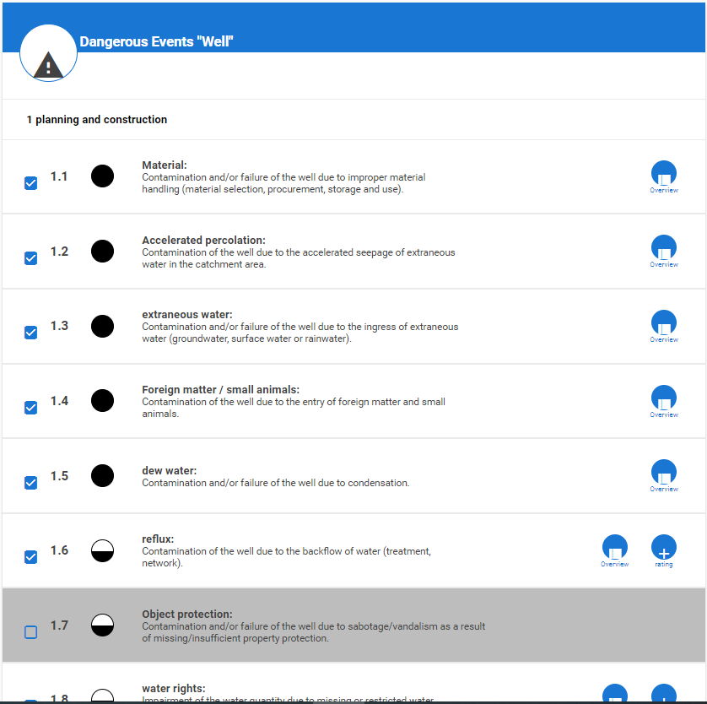
Hazard Analysis
Hazard analysis based on prepared lists
Lists with hazardous events, which address effects on safety and security
Hazards in form of qualitative (biological, chemical, physical) and quantitative (continuity, volume, pressure) impairments
Numbers:
  6 processes
  17 types of infrastructure elements
  273 hazardous events
  (categories: planning, construction, operation, maintenance)
  568 measures of risk control
© 2022 IWW Water Centre
Automatic translation with Google Translate

Slide 7
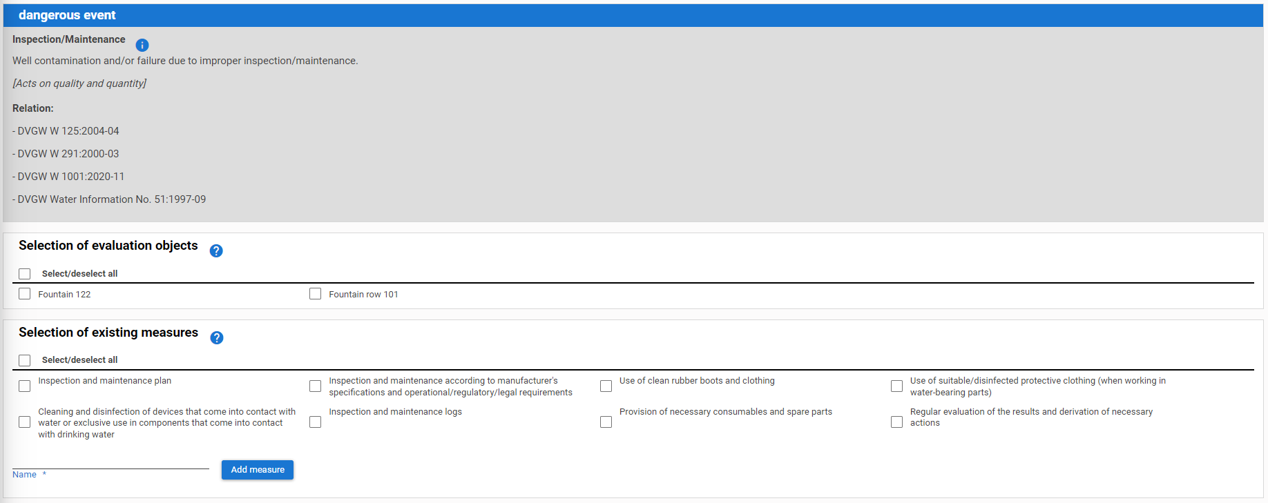
Risk assessment
© 2022 IWW Water Centre
Automatic translation with Google Translate
Hazards and hazardous events are assessed with regard to their risks for each supply element using a 3x3 risk matrix
Assessment taking into account existing measures (for control or mitigation) which have been compiled on the basis of the DVGW standards and further regulations
Possibility of using suggested definitions or supplier-specific definitions for the likelihood and severity

Slide 8
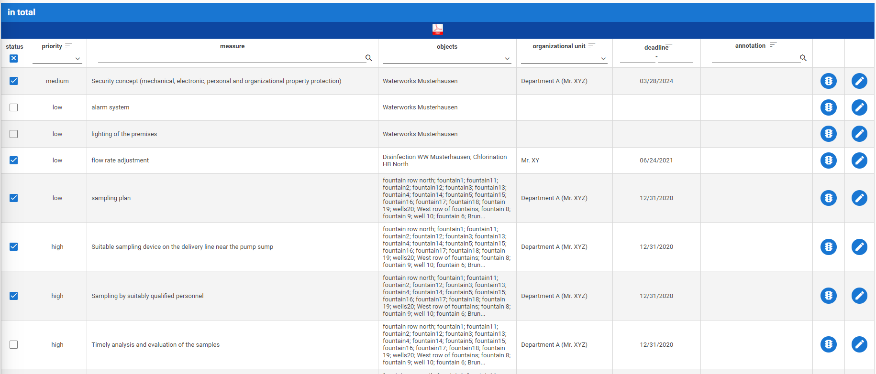
Risk Control
© 2022 IWW Water Centre
Automatic translation with Google Translate
© 2022 IWW Water Centre
Automatic translation with Google Translate
If the identified risk is too high, further measures can be defined with corresponding deadlines and responsibilities
It ist possible to change the status of measures from “to do” to “done”
All tables can be filtered and exported in the filtered view

Slide 9
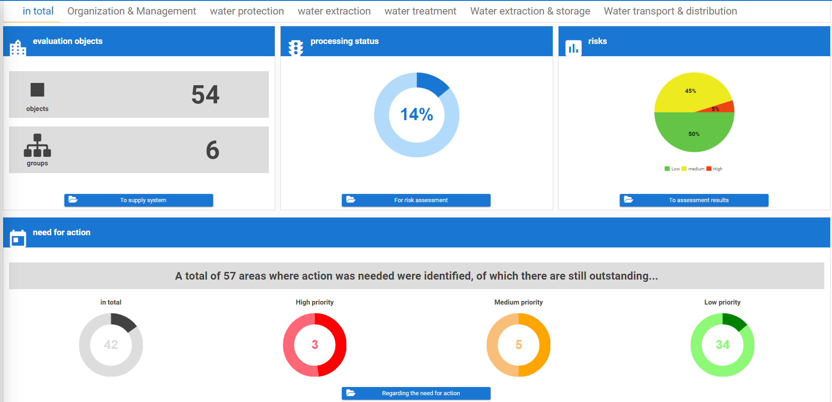
VerificatioN, Documentation, Review
© 2022 IWW Water Centre
Automatic translation with Google Translate
Documentation in form of tables and dashboard
Update of the lists of hazardous events and mearures of risk control twice a year by IWW (especially in the case of changes in the regulations)
Risk management is to be used continuously via TRiM®online. It is possible to compare different years within with regards to a review.

Slide 10


Contact Details
Address
  IWW Zentrum Wasser
  Moritzstr. 26
  45476 Mülheim an der Ruhr
  Germany
Contact us:
  Phone: +49 (0) 208 40303-0
  e-mail: info@iww-online.de
Martin Offermann
  e-mail: m.offermann@iww-online.de

